Slide 1
Shadowbuffers
Tom Forsyth
RAD Game Tools

Slide 2
Terminology
View/viewspace = current D3D target
Light POV = light point of view
  Placing the viewer where the light is
Camera POV = what the gamer sees
  Conventional idea of a viewer
Shadowbuffer/shadowmap
  Both the same thing
  To me, "buffer" = dynamic, "map" = static
Other people use other conventions!
  (so do I sometimes - oops!)

Slide 3
Principles
Render scene from light point of view
  Render to shadowbuffer texture
  Store a surface identifier
    Depth, ID, whatever
  Use standard Z-buffer occlusion
  Closest thing to light is stored in buffer
    By definition, it can see the light = it is lit
  All things behind it are invisible to light
    Can't see the light = in shadow
  So surface ID in shadowbuffer is the lit one

Slide 4
Principles 2
Render scene from camera POV
  Project shadowbuffer texture
  Same projection maths as previous pass
    Scale 0-512 pixels to 0-1 UV coords
  Compute the surface ID the same way
  Read the shadowbuffer
  Compare computed & read IDs
  If they match, this surface can "see" the light
    So it's drawn lit
  If not, something in the way, so draw shadowed

Slide 5
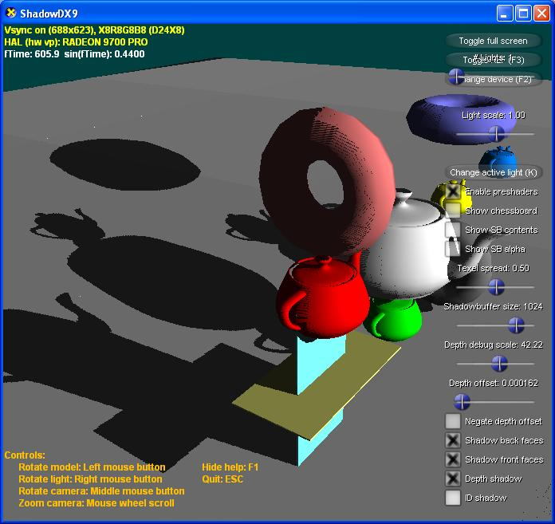

Slide 6
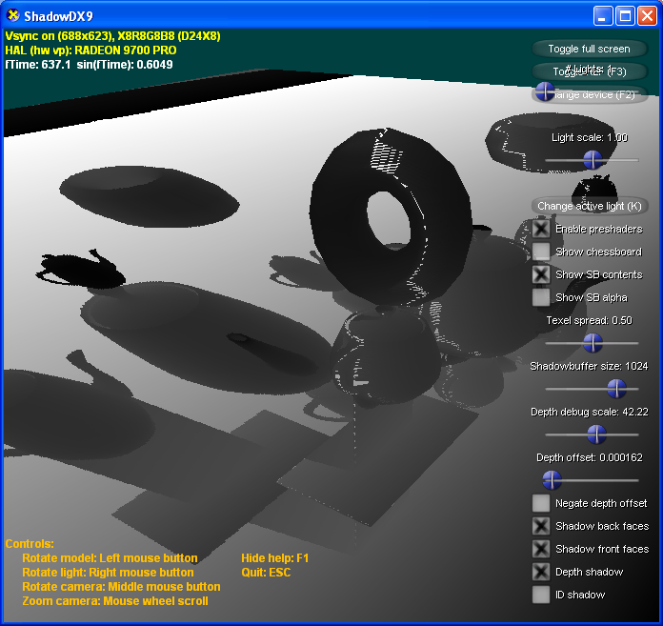

Slide 7
Major hurdles
Which method of shadowbuffering?
  What shader algorithm do we use?
  What space/speed requirements does it have?
  How robust is it?
How do you choose the frustum?
  Mitigating aliasing problems
  Concentrating fillrate where it counts
Making soft shadows
  Look far better than hard shadows
  But how?

Slide 8
  Which method?

Slide 9
Depth shadowbuffers
Surface identifier = distance from light
Can be same values as Z buffer
Depth shadowbuffer can be the Z buffer
  Depends on hardware support
if computed.depth > texture.depth
  Object must be further from light
  Therefore shadowed
else
  Object visible to light
  Therefore lit

Slide 10


Slide 11
Depth shadowbuffers 2
Simple in theory
Lots of annoying problems in practice
Incorrect self-shadowing
  "Surface acne"
Shadows detaching from objects
  "Peter Pan" syndrome
Hardware support is variable
  Often needs high-precision buffers

Slide 12
Surface acne
Incorrect self-shadowing on lit surface
Caused by sampling differences
  Value read from shadowbuffer is quantised
  Computed value is not
Frequency quantisation: not enough bits
  8 bits not enough
  24 bits = same as Z buffer = enough
Spatial quantisation: small shadowbuffer
  Gets very expensive very quickly
  In practice, hardware & speed are limits

Slide 13
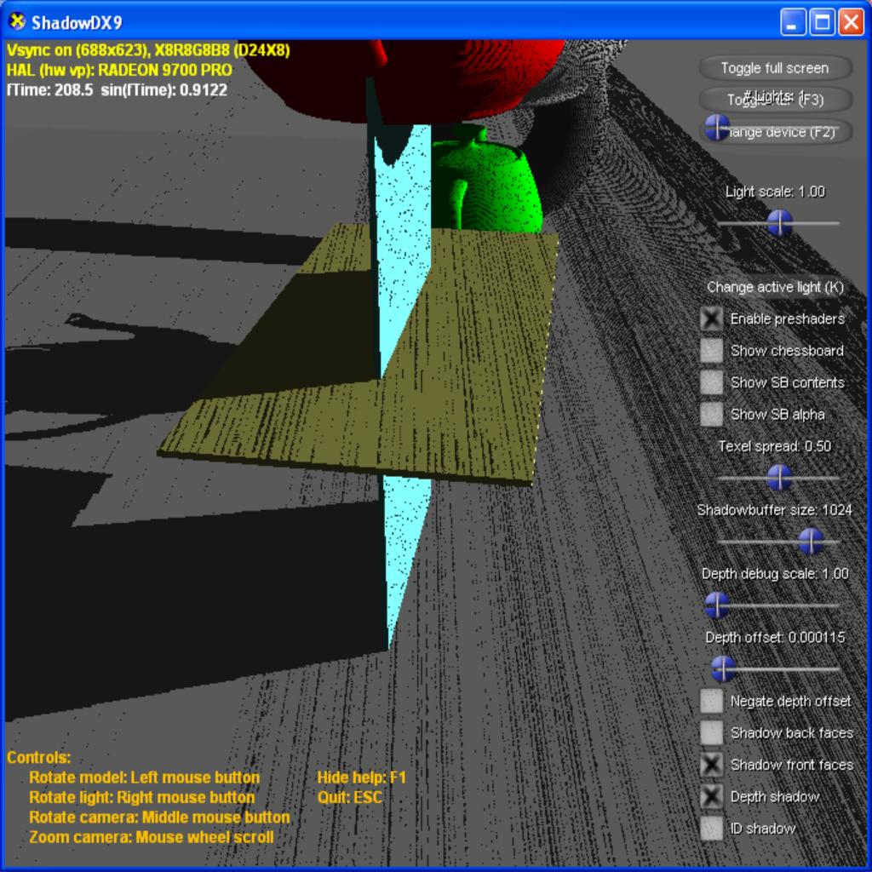

Slide 14
Surface acne - cures
Surface acne is not a bug!
  Fundamental side-effect of aliasing
  Inherent in every image-based system
Use more bits
  2x precision = 1 more bit
  Fairly cheap, but careful of hardware support!
Use bigger textures
  Far more expensive
  2x precision = 4x memory & fillrate
In practice, resolution is the limiter

Slide 15
Surface acne - cures 2
Use a bias
  Make it bigger than the quantisation errors
  But errors are slope-dependent!
Use a slope-dependent bias
  Doesn't cope well with irregular surfaces
  Bias can get very large for edge-on surfaces
  Helps, but not very much
Biases cause Peter Pan syndrome
  Shadows detaching from their casters

Slide 16
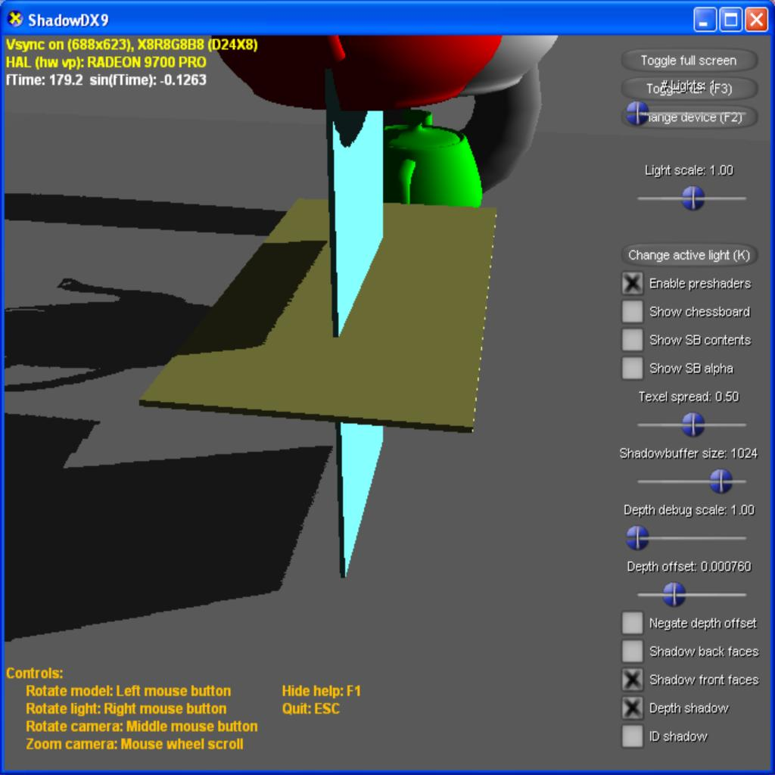

Slide 17
Shadows don’t meet objects. The cyan block actually intersects the yellow one and the grey ground plane, but it doesn’t look like it here.

Slide 18
Peter Pan vs Acne
Large biases cause shadows to detach
  Shadow values pushed through objects
Small biases cause surface acne
Some biases cause both!
  Different areas of a scene show different ones
  In practice, no bias causes neither :-(
Could render backfaces to shadowbuffer
  Acne is invisible on unlit backfaces
  Error still large enough on thin objects
  Relies on objects being closed
  Causes even worse Peter Pan problems!

Slide 19
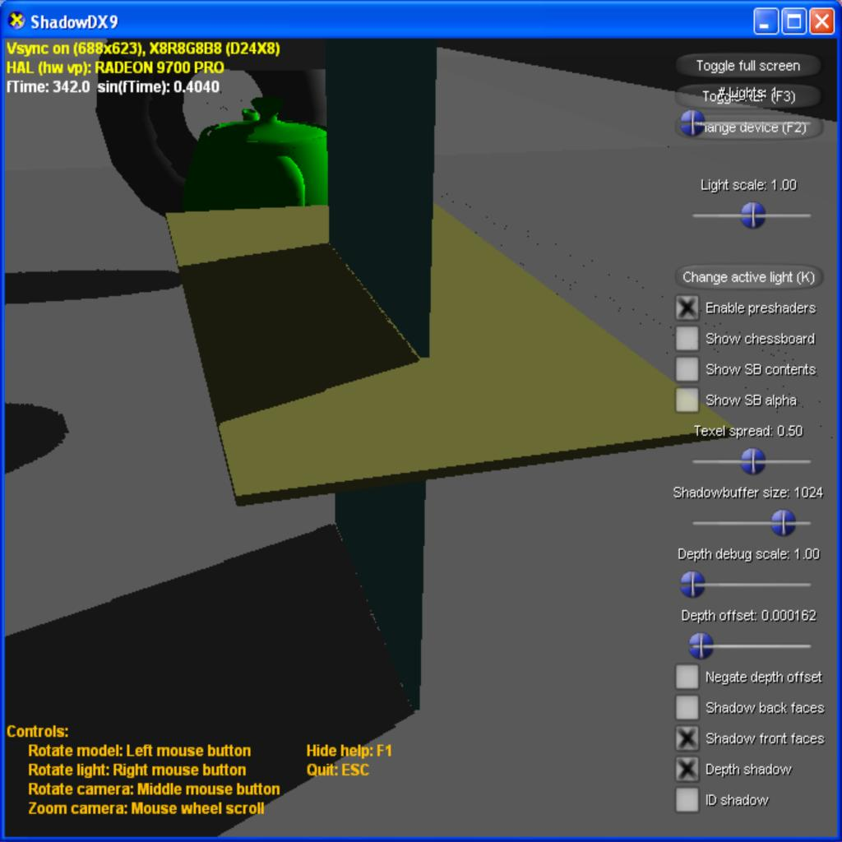

Slide 20
Surface acne here
Peter Pan effect here

Slide 21
Depth shadowbuffers 3
Lots of interesting research
Smarter biases: Gradient Shadow Maps
  Christian Schueler (ShaderX4, ShaderX5)
Smarter sampling: Irregular Z buffer
So far, nothing works for everything
  Large flat areas at glancing angles
  Curved or bumpy areas
  Thin areas
  Objects resting or interpenetrating
  Combinatorial nightmare - tune it for one situation and it fails for another

Slide 22
ID shadowbuffers
Don't need to use depth
Shadowing asks simple question
  "Is the surface in the shadowbuffer me?"
Just need something to identify surface
Can just pick an integer
  Here shown as a shade of grey

Slide 24
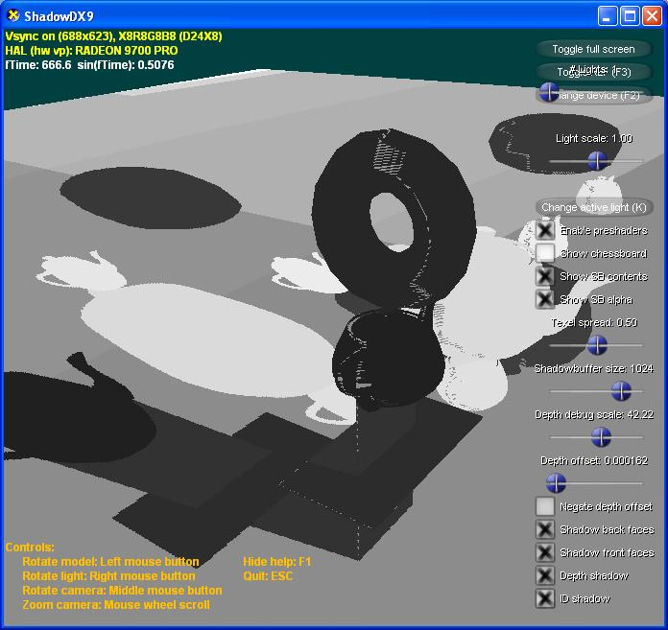

Slide 25
ID shadowbuffers 2
Per-triangle integer
  Needs hardware support (some ATI cards)
  DX10 will have primitive ID as standard
  Needs lots of integers - 16 bits+
  Pixel-sized triangles can get “lost”
    Causes acne
Per-object integer
  No hardware support needed
  8-bit ID will do fine - 256 objects in scene
    For more, check light-space bounding boxes

Slide 26
ID shadowbuffers 3
"Edge acne"
  Sampling misses the edge of an object
  Hits object behind
  IDs don't match => shadowing
  (depth shadowbuffers have an implicit order)
Can sort objects back to front
  Expensive, sometimes not possible
Sample nearest four neighbour texels
  Only shadow if all four don't match
  Careful with user-set control-panel texel offsets!

Slide 27
Edge acne – shadowbuffer is sampling the ground plane here

Slide 28
ID shadowbuffers 4
No maths is done on the IDs
  No frequency aliasing problems
  Simple shaders
  No biases or tweaks needed
  No acne or Peter Pan problems
  Robust & predictable
But no self-shadowing
  Whole of an object is same ID
  Can't cast shadows on itself
  Not critical in some games

Slide 29
Depth vs ID
Depth
  Surface acne and Peter Panning
  Large shadowbuffer surfaces
  Bias is fiddly & scene-dependent
IDs
  Small surfaces = fast
  Robust - write once, works everywhere
  No self-shadowing

Slide 30
Depth + ID
So use both!
ID for inter-object (non-self) shadowing
  No Peter Pan problems
  No acne by definition
  Works whatever the scene
Depth for intra-object (self) shadowing
  0-1 depth only covers one object at a time
    So can use smaller buffer - 8 bit usually fine
  Bias tweaked for that object
  Can have different biases for different objects

Slide 31
Depth + ID 2
Shadowbuffer is small
  8bit ID + 8bit depth
  No special hardware required
if object.ID != buffer.ID
  inter-object shadow
else if object.depth - bias > buffer.depth
  object self-shadows
else
  lit

Slide 32
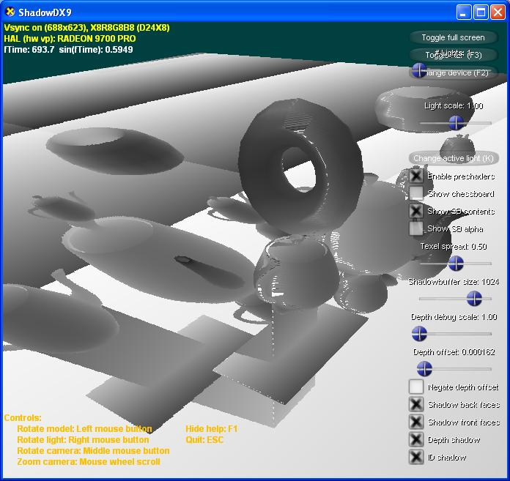
Local depth buffer shown. Dark = near, bright = far
Using full range of depth across each object, so 8 bit depth is enough precision for self-shadowing

Slide 33
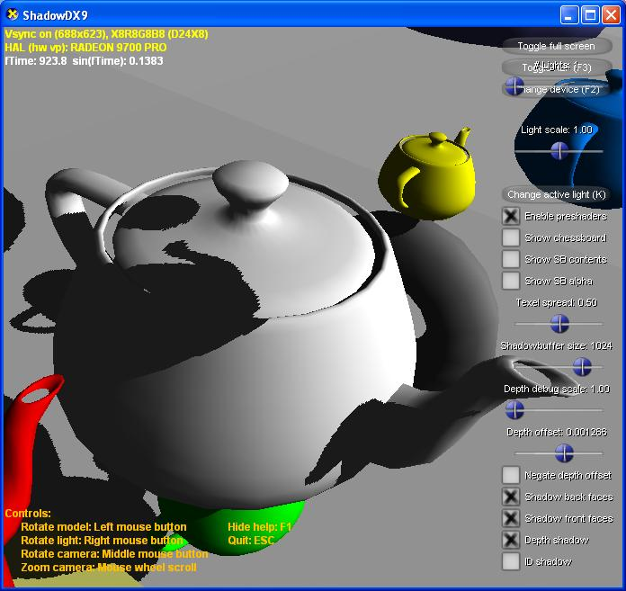
16-bit depth buffer only
Peter Pan on the lid handle shadow. A smaller bias would cause acne

Slide 34
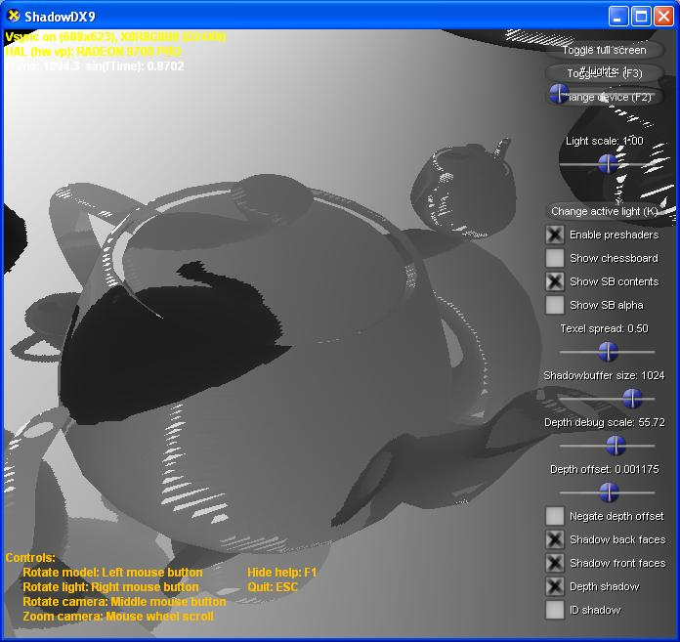
16-bit depth buffer only – showing depth (exaggerated scale)

Slide 35
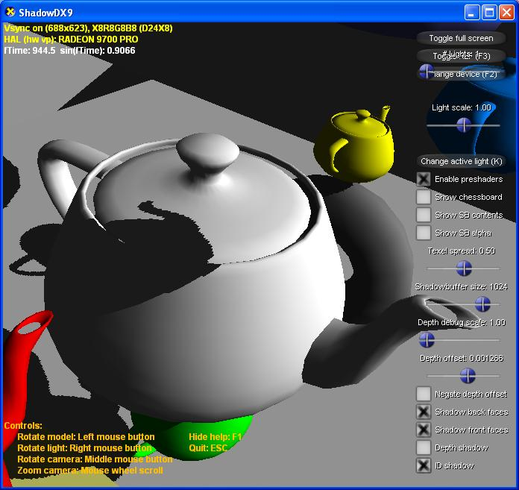
8-bit ID buffer only
No self-shadowing on lid handle or spout

Slide 36
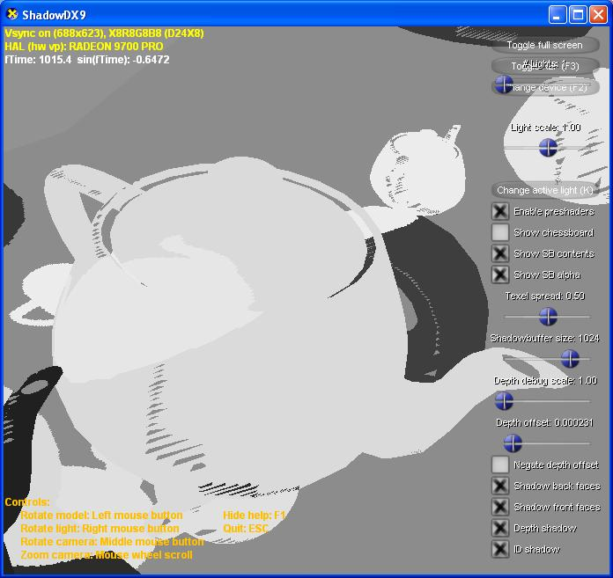
8-bit ID buffer only – showing IDs

Slide 37
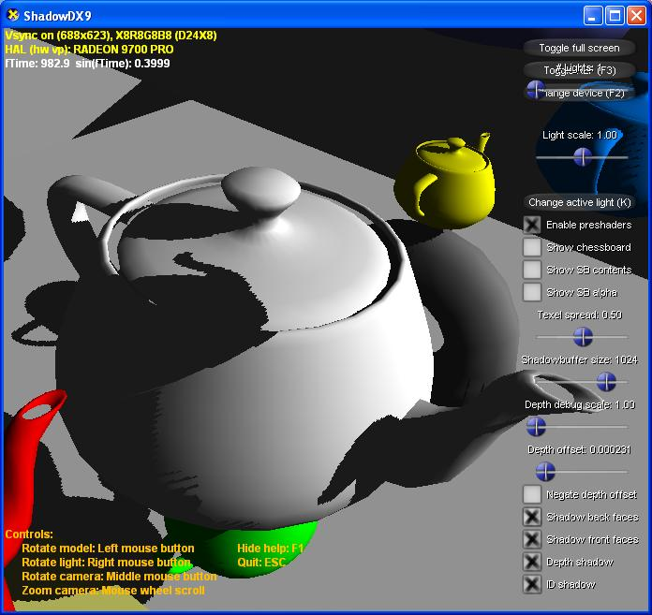
8-bit ID + 8-bit depth
Self-shadowing and no Peter Pan problems

Slide 38
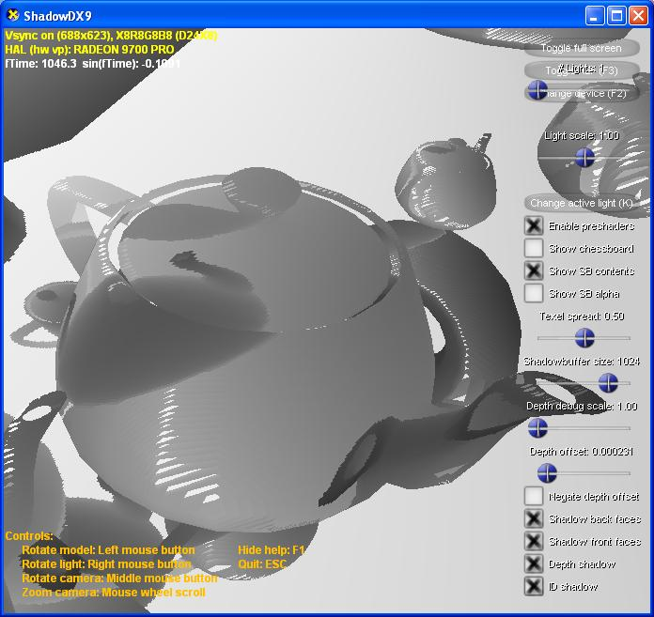
8-bit ID + 8-bit depth – showing depth

Slide 39
Demo...

Slide 40
Which frustums?

Slide 41
Shadowbuffer frustums
Frustum = pyramid of rendered scene
Position + direction + depth + FOV
Shadowbuffers need frustums too
  But they can sometimes get strange
Position = light position
Depth = usually not a big problem
But direction + FOV are difficult

Slide 42
The projection problem
Shadowbuffer rendered from light POV
Then projected into camera POV
The two do not agree
  Can violently disagree - "duelling frustums"
Too many texels in some places
  Inefficient use of memory & fillrate
Too few texels in others
  More visible aliasing

Slide 43
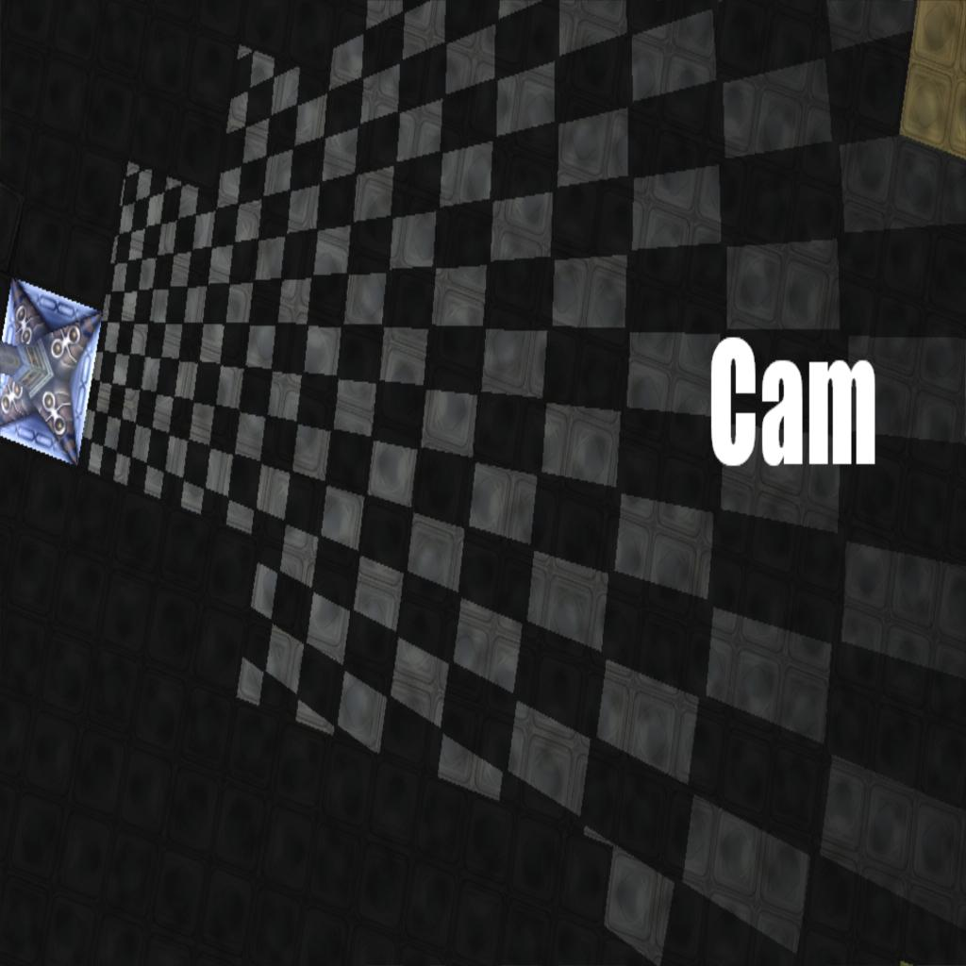
Overhead view

Slide 44
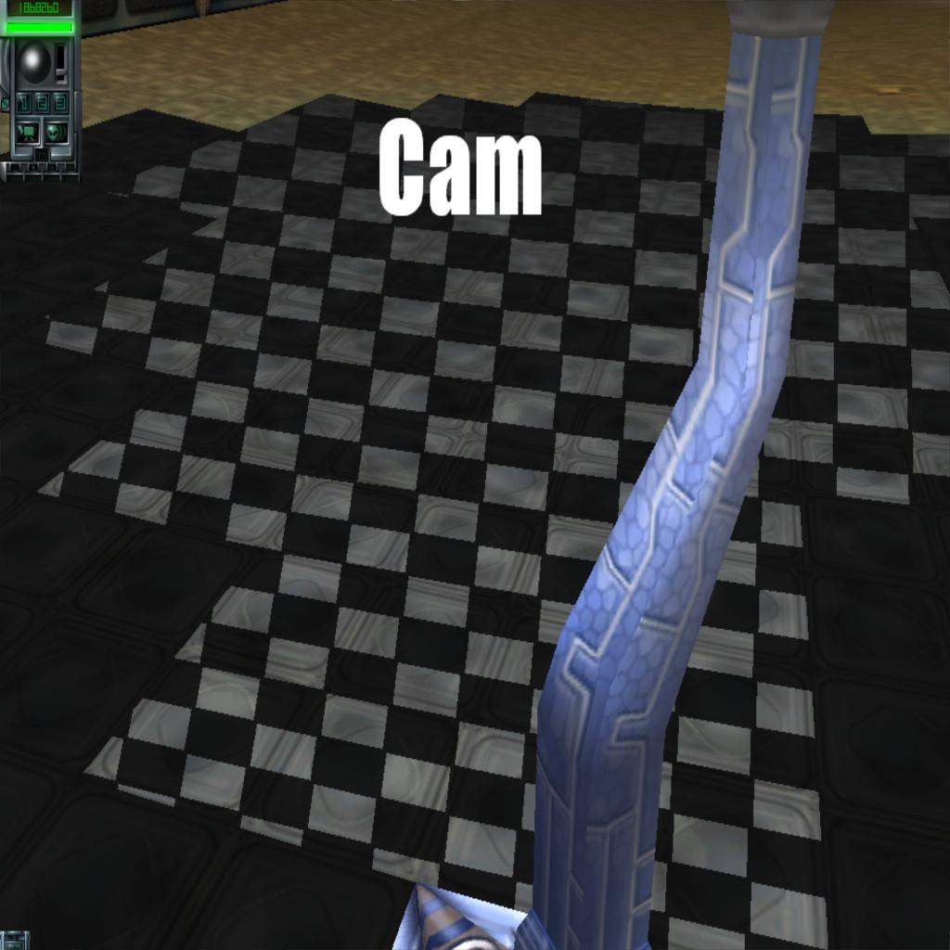
From the light POV

Slide 45
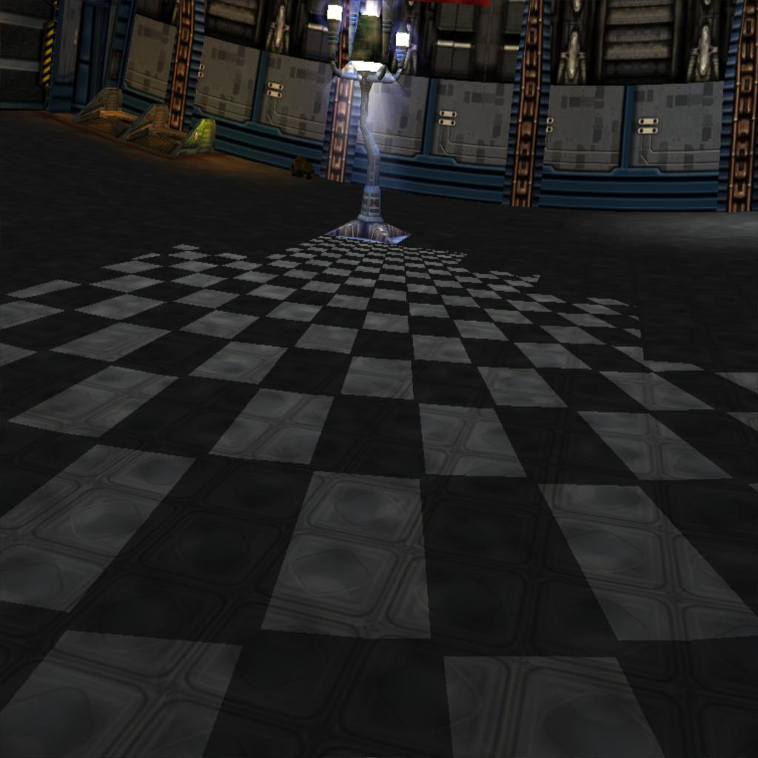
From the camera POV

Slide 46
Smarter projection solutions
Use extra freedom in the projection
  Frustum doesn't have to look sensible!
Perspective Shadow Maps
  Flaky, full of special cases - avoid
Light-space Persp. Shadow Maps
  (LiSPSM)
  More robust than PSM, but more complex
Trapezoidal Shadow Maps (TSM)
  Needs complex shader support
  Tuned for terrains, not arbitrary worlds

Slide 47
Smarter projection problems
None of them solve duelling frustums
  All degenerate to standard projection
They can cause worse depth aliasing
  Flexibility traded for spatial aliasing
None of them solve omni-lights
  Omni lights have 360-degree FOV!
  Frustum cannot have >180
  Practical limit is around 120 degrees
  Also, guaranteed duelling frustum
    Some part of the light is "facing" the camera

Slide 48
Multi-frustum partitioning
Splits scene into multiple frustums
  Each frustum rendered separately
  Conventional frustum for each section
Solves the two big problems
  Duelling frustums
  Omni lights
Helps in other ways
  Copes gracefully when smart projection fails
  ...allows "dumber" smart projection
  Can alleviate depth aliasing problem

Slide 49
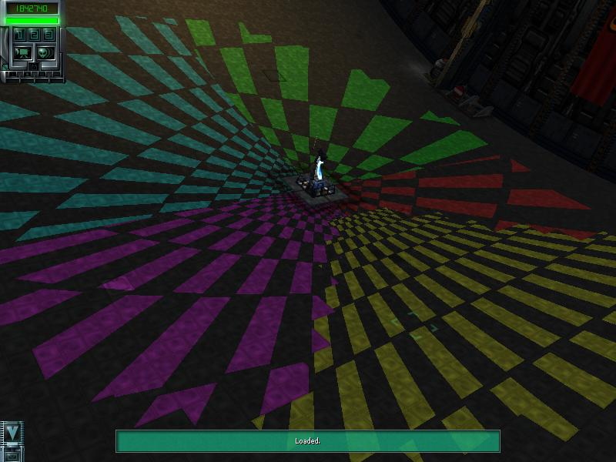
Omni with multiple frustums

Slide 50
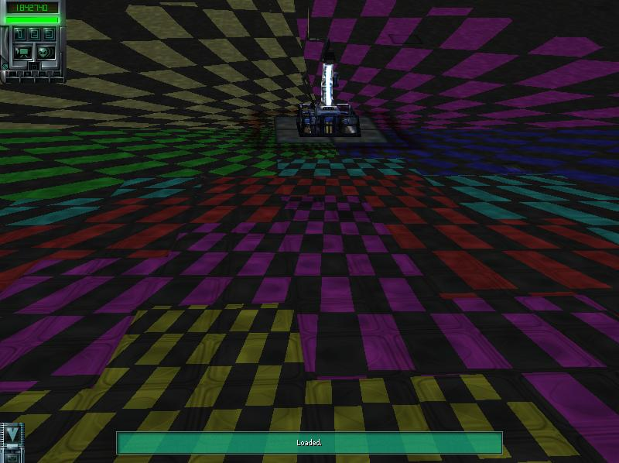
Omni with duelling frustums

Slide 51
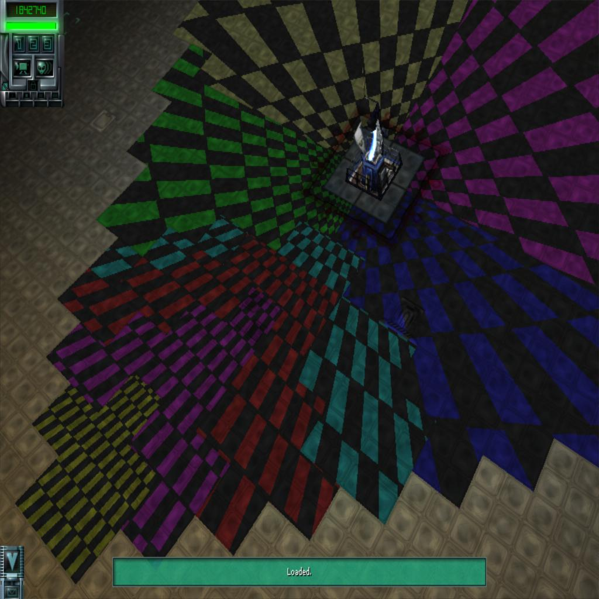
Same, from above

Slide 52
MFP + smart projection
MFP simply partitions the scene
Each frustum can be "smart"
  Different frustums can be differently smart
  Where one has a problem, use another
MFP can partition to avoid problems
  Can dumb down the smart projections
  Just solve problems by more partition
MFP can just work with naïve frustums
  Reliable fallback

Slide 53
MFP results
Retrofitted to StarTopia (2001)
  RTS/"god game"
  Player-built world - no preprocessing possible
No gameplay or artwork changed
  Already had local lights (but no shadows)
  All lights are omnis - rampant duelling!
  Truly robust
More details at <date/time>ww.eelpi.gotdns.org
  Subject far too big to cover in the time

Slide 54
Soft Shadows

Slide 55
Soft shadows
More realism
Hides aliasing
  Allows use of lower-rez shadowbuffers
Gives depth cues
  Further from lightsource = softer

Slide 56
Simple blurring
Not for realism, just to reduce aliasing
Percentage Closer Filtering
  Make multiple samples from shadowbuffer
  Test each sample for shadowed/lit
  Result is the percentage of lit
Requires a lot of samples
  64 samples = 6 bits of grey
Can make it adaptive
  Only sample lots at shadow edges

Slide 57
Depth-dependent softness
Simulates an area light
  Objects can occlude all or part of the light
  Penumbra formed at partial occlusion
Penumbra wedges (Assarson)
  Fusion of shadowbuffers and volume shadows
  Needs watertight manifold meshes
  Needs lots of fillrate

Slide 58
Depth-dependent softness
Smoothies (Chan, Durand)
  Not physically correct
    Shadows only blur outwards, not inwards
  Less fillrate demand than Penumbra Wedges
  Hides spatial aliasing really well
  But still needs watertight manifolds
    Uses them to find silhouette edges
Willem de Boer's work
  Similar to Smoothies
  But generates edges in image-space
  So no geometric restrictions

Slide 59
Summary
ID+depth = best of both world
  This seems like the right solution - solved!
Frustum choice is tricky
  There are solutions, but they're all complex
  Still some engineering problems to solve
Soft shadows are very tricky
  Lots of interesting research
  None works completely yet
  Still expensive
  But progress is swift!

Slide 60
Questions?
  More available from
  www.eelpi.gotdns.org

